Slide 1

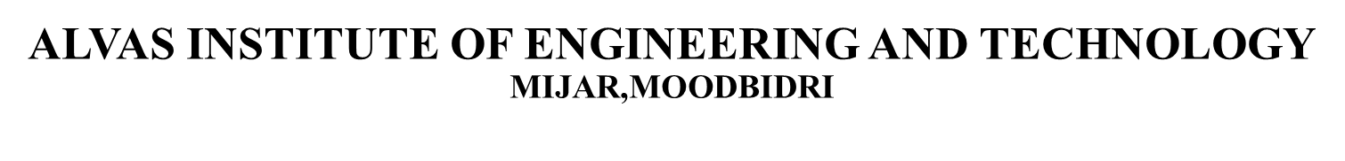
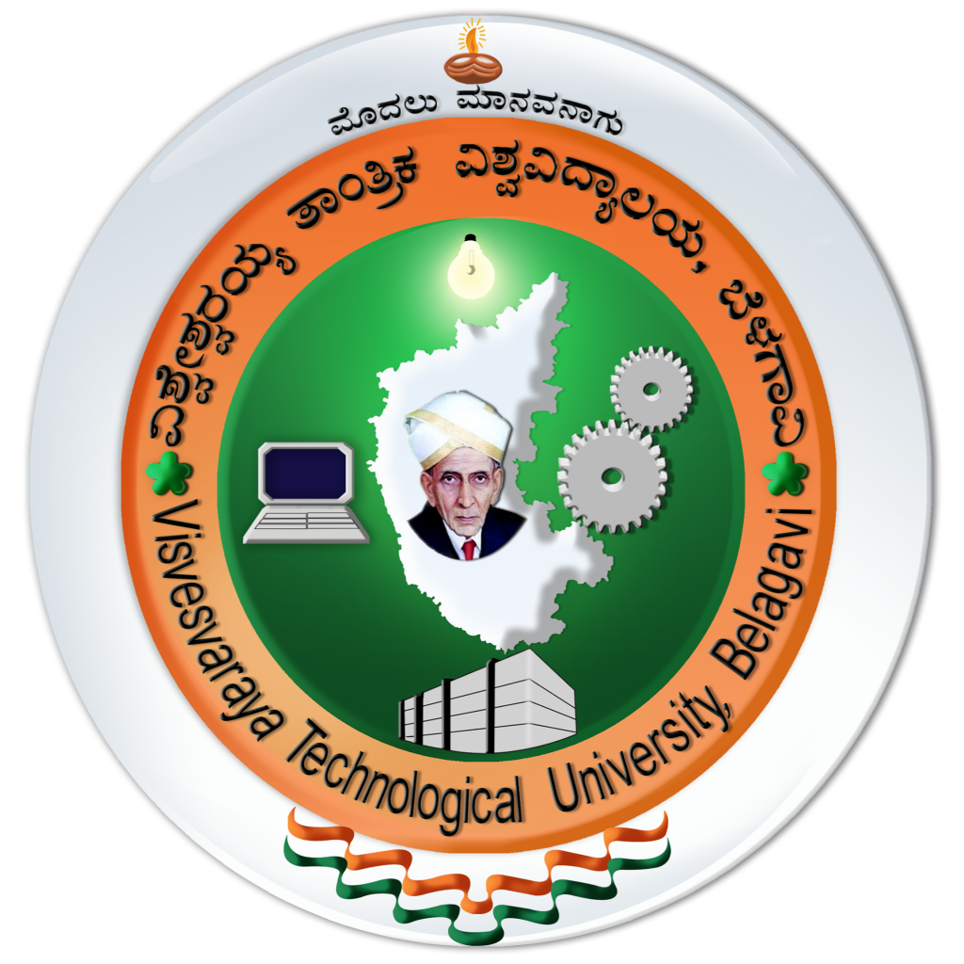
LoRa and IoT based smart irrigation system
Guide:
Dr.Guruprasad B
Assistant Professor ,AIET
Presented by:
4AL19EC001 - A V VEDANTH
4AL19EC008 - ABHISHEK P
4AL19EC027 - DARSHAN S N
4AL19EC037 - JAISON V J

Slide 2
CONTENT
1.Introduction
2.Problem statement
3.Proposed System
4.Literature Survey
5.Block diagram
6.Advantages
7.Applications
8. Reference

Slide 3
INTRODUCTION
Water resource one of the most important natural resource problem to be paid more attention in the world in 21st Century.
Irrigation method in traditional agriculture has low utilization of water resource with the development of IoT in this system.
In our project irrigation node sends data to cloud through LoRa gateways via wireless transmission. The system can be controlled manually and remotely by mobile applications.

Slide 4
PROBLEM STATEMENT
Farmers used to turn ON the bore well in order to deliver the water to the agriculture field and later they need to turn OFF the motor after checking the enough availability of water in the agriculture field.
150-200 farmer dies due to snake bite and animal attack every year while they go to turn ON the motor pump during night time.
Wastage of water due to pipeline breakage and over watering.

Slide 5
PROPOSED SYSTEM
LoRa WAN
→ Communication between home and agriculture field.
→ Replace existing GSM model.
IoT(Internet of things)
→ Cloud updation.
→ App control.
→ Voice control.
LoRa
IoT
MANUAL CONTROLLING
→Manually controlling from home ,the region where the internet connection is not available.
USAGE OF SENSORS
→Pressure sensor to analyse Water pipe breakage.
→Soil moisture monitoring.
Manual
Sense

Slide 6
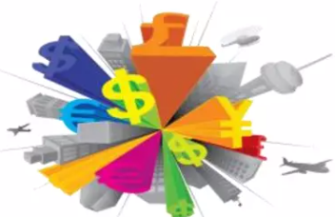

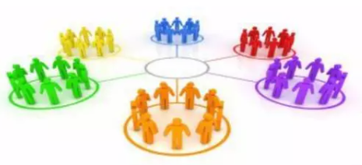
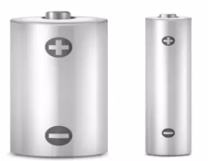
WHY LoRa ?
LONG RANGE
→ 2 - 10+ Km .
→ Indoor coverage.
→ Star topology.
MAX LIFETIME
→ Low power optimized.
→ 5-10yr lifetime.
→ Energy efficient.
MULTI USAGE
→ High capacity.
→ Multi-tenant.
→ Public network.
LOW COST
→ Minimal infrastructure.
→ Low cost end-node.
→ License-free spectrum.

Slide 7
LITERATURE SURVEY
Daveev [1],This paper shows the useful methods that can be used in smart agriculture system with the help of LoRa technology. The sensor nodes are connected with LoRa modules in order to transfer the sensor data to the processing system, in order to upload it on cloud platform.
C. Bouras [2], WiFi & LoRa as wireless technologies have been compared initially, however the end devices require high power consumption for processing and thus there is requirement of low power network technologies. Experiments carried out on real time basis indicate that LoRa could be an ideal option for building smart rescue monitoring

Slide 8
LITERATURE SURVEY
3. C. S. Gaddam [3], This paper shows the WAN technology i.e LPWAN is popular and leading technology created for IoT networks. LPWAN is wireless based WAN technology that enables Low power consumption, long range, lower bandwidth with low bit rates.
4. A. Lavric [4], Long-range transfer of information is enabled by LoRa modules, with a low transfer rate. Considering the requirements this paper presents the evaluation of the LoRa technology in the field of IoT and Architecture requirements of LoRaWAN communication protocol have been discussed along with the evaluation of LoRa modulation performance.

Slide 9
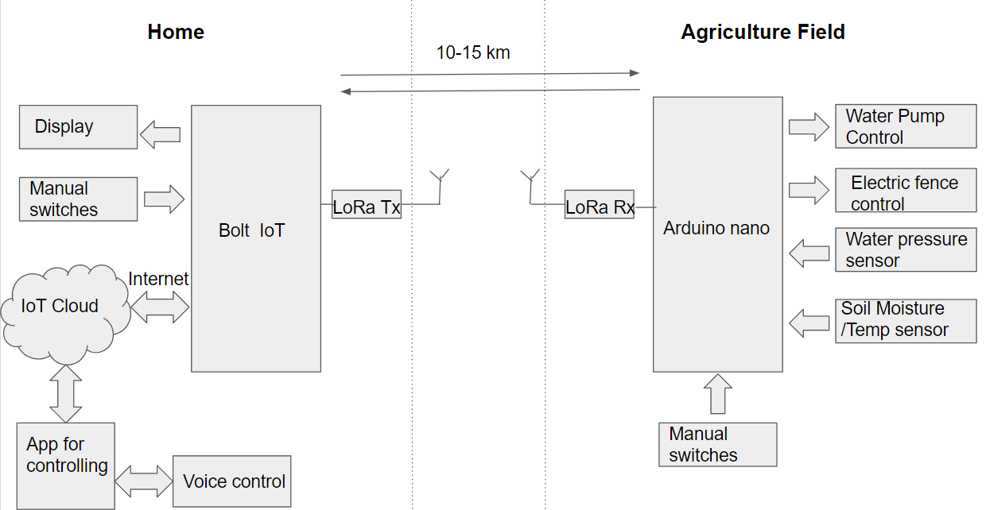
BLOCK DIAGRAM

Slide 10
ADVANTAGES
1.Can resist Minimizing current consumption.
2.High reliability.
3.Maximum range of 10 km.
4.Allow small farms to have affordable precision irrigation (low cost).
5.Provides of solution for scarcity of water.
6.Helps to get good yield for farmers.

Slide 11
APPLICATIONS
1.Parking Occupancy System - PNI
2.Smart Waste Management
3.Tank Monitoring
4.Cattle Tracking and Health
5.Cold Storage Management.
6.Smart Metering

Slide 12
REFERENCES
Daveev, K. Mitreski, S. Trajkovic, V. Nikolovski and N. Koteli, "JoT agriculture system based on LoRaWAN," 2018 14th IEEE International Workshop on Factory Communication Systems (WFCS), Imperia, 2018.
| C. Bouras, A. Gkamas, V. Kokkinos and N. Papachristos, "Using LoRa Technology for IoT Monitoring Systems," 2019 10th International Conference on Networks of the Future (NoF), Rome, Italy, 2019.
C. S. Gaddam and M K. Rai, "A Comparative Study on Various LPWAN and Cellular Communication Technologies for IoT Based Smart Applications," 2018 International Conference on Emerging Trends and Innovations In Engineering And Technological Research (ICETIETR), Ernakulam, 2018,
A. Lavric and V Popa, "Internet of Things and LoRa™ Low-Power Wide-Area Networks: A survey," 2017 International Symposium on Signals, Circuits and Systems (ISSCS), Iasi, 2017

Slide 13
Thanks!
Any questions?

